Slide 1
What is ARIMA

Slide 2
ARIMA stands for AutoRegressive Integrated Moving Average.
It is a statistical model used for analyzing and forecasting univariate time series data.
ARIMA assumes that past values and past errors can help predict future values.
The model is defined by three parameters: p, d, q:
p: Number of autoregressive terms (AR)
d: Number of times the data needs to be differenced to make it stationary (I)
q: Number of moving average terms (MA)

Slide 3
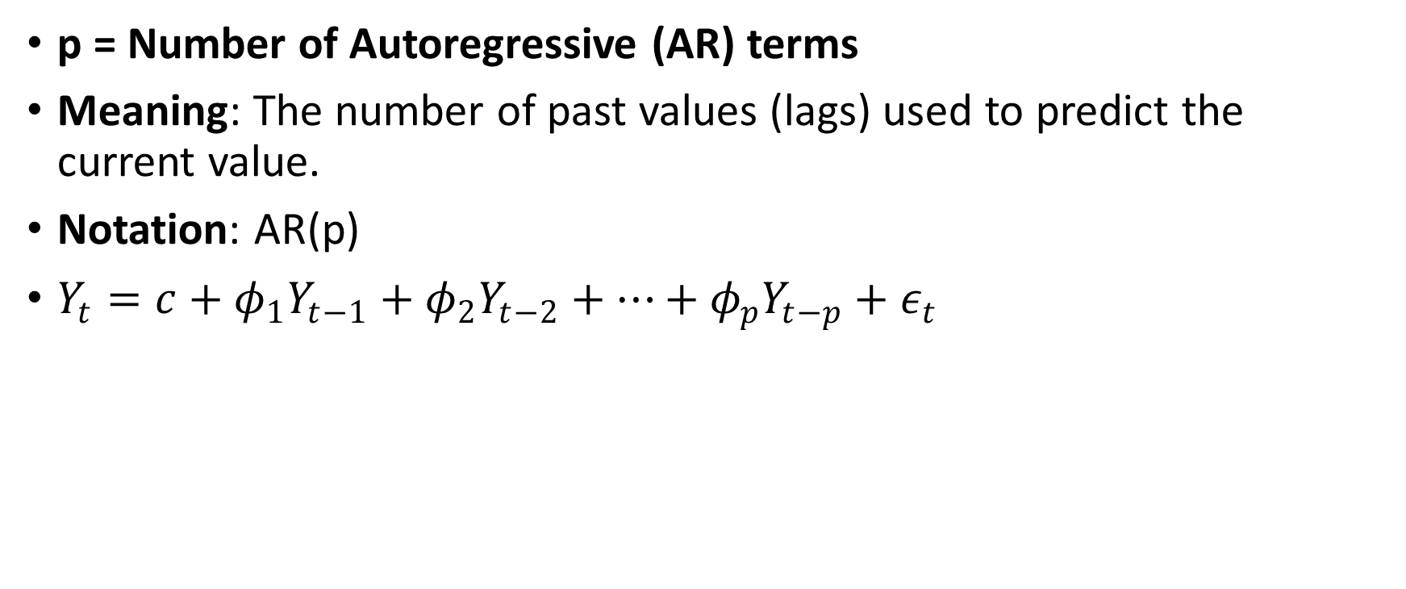
p = Number of Autoregressive (AR) terms
Meaning: The number of past values (lags) used to predict the current value.
Notation: AR(p)
$Y_{t}=c+φ_{1}Y_{t−1}+φ_{2}Y_{t−2}+…+φ_{p}Y_{t−p}+ε_{t}$

Slide 4
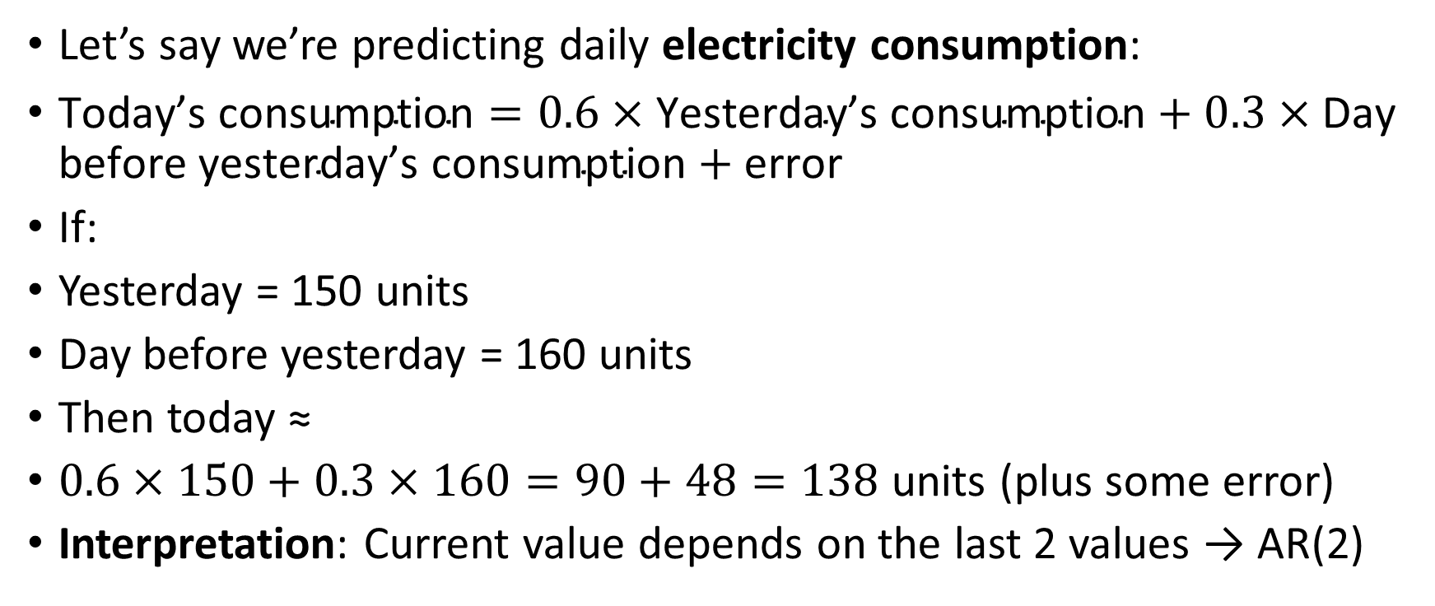
Let’s say we’re predicting daily electricity consumption:
$\text{Today}\text{’}\text{s} \text{consumption}=0.6×\text{Yesterday}\text{’}\text{s} \text{consumption}+0.3×\text{Day} \text{before} \text{yesterday}\text{’}\text{s} \text{consumption}+\text{error}$
If:
Yesterday = 150 units
Day before yesterday = 160 units
Then today ≈
$0.6×150+0.3×160=90+48=138$ units (plus some error)
Interpretation: Current value depends on the last 2 values → AR(2)

Slide 5
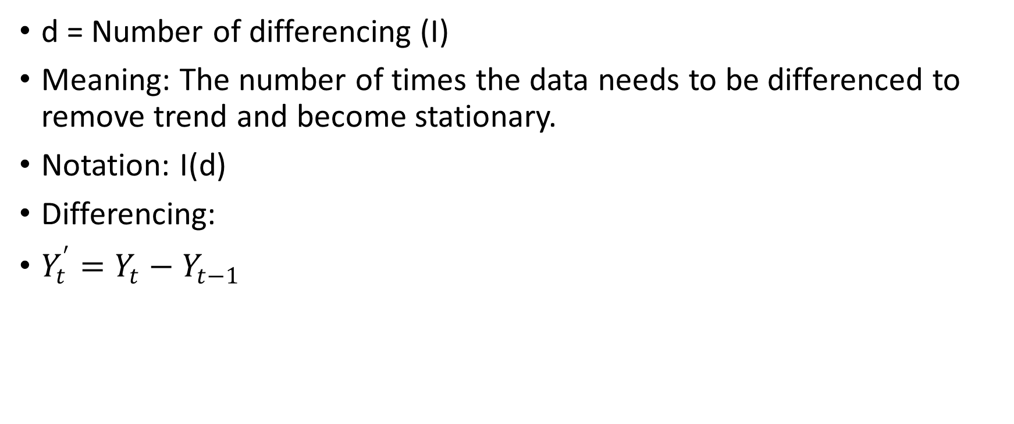
d = Number of differencing (I)
Meaning: The number of times the data needs to be differenced to remove trend and become stationary.
Notation: I(d)
Differencing:
$Y_{t}^{′}=Y_{t}−Y_{t−1}$

Slide 6
d = 1
Original time series:
Day 1 = 100
Day 2 = 105
Day 3 = 110
Day 4 = 115
This shows a clear increasing trend (non-stationary).
Apply first difference:
Day 2 − Day 1 = 5
Day 3 − Day 2 = 5
Day 4 − Day 3 = 5
Resulting series: [5, 5, 5] — now it's stationary.
We applied 1 differencing, so d = 1

Slide 7
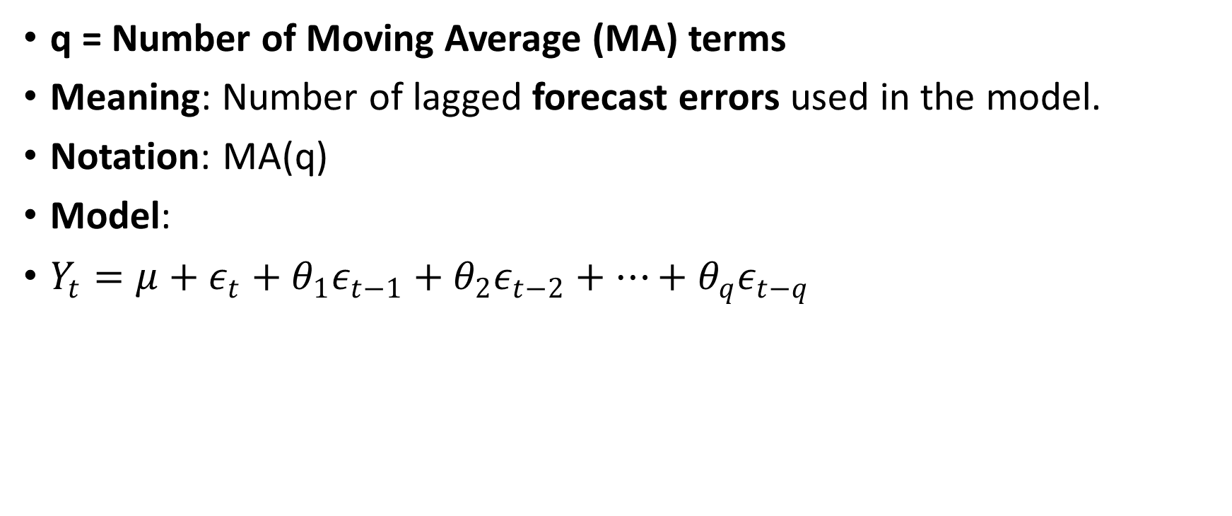
q = Number of Moving Average (MA) terms
Meaning: Number of lagged forecast errors used in the model.
Notation: MA(q)
Model:
$Y_{t}=μ+ε_{t}+θ_{1}ε_{t−1}+θ_{2}ε_{t−2}+…+θ_{q}ε_{t−q}$

Slide 8
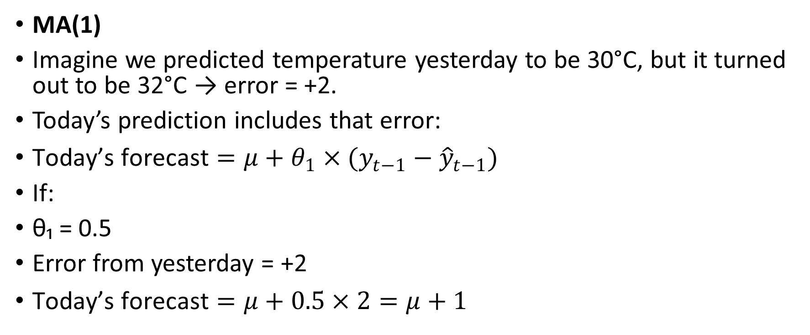
MA(1)
Imagine we predicted temperature yesterday to be 30°C, but it turned out to be 32°C → error = +2.
Today’s prediction includes that error:
$\text{Today}\text{’}\text{s} \text{forecast}=μ+θ_{1}×(y_{t−1}−{\hat{y}}_{t−1})$
If:
θ₁ = 0.5
Error from yesterday = +2
$\text{Today}\text{’}\text{s} \text{forecast}=μ+0.5×2=μ+1$

Slide 9
μ?
It’s a constant term — the expected average value of the stationary time series.

Slide 10
Determining the Order of Differencing (d)
Differencing is used to remove trends and make the time series stationary.
Steps: Plot the time series
Check for stationarity using:
ADF Test (Augmented Dickey-Fuller)
KPSS Test
Start with d = 0, increase until stationarity is achieved.
Typically, d = 1 or 2 suffices.

Slide 11
Month | Sales
Jan | 100
Feb | 110
Mar | 120
Apr | 130
May | 140
We observe a steady upward trend.

Slide 12
Subtract each value from its previous value:
Month | Sales | First Difference
Feb | 110 | 110 - 100 = 10
Mar | 120 | 120 - 110 = 10
Apr | 130 | 130 - 120 = 10
May | 140 | 140 - 130 = 10
The first difference is constant: [10, 10, 10, 10]
Now the series has no trend — it's stationary.
So, d = 1 is sufficient.

Slide 13
ADF (Augmented Dickey-Fuller) Test
This test checks for a unit root (i.e., non-stationarity).
Null Hypothesis (H₀): Series is non-stationary
Alternative Hypothesis (H₁): Series is stationary
If p-value < 0.05 → reject H₀ → series is stationary

Slide 14
KPSS Test
This checks the opposite:
Null Hypothesis (H₀): Series is stationary
Alternative Hypothesis (H₁): Series is non-stationary
If p-value > 0.05 → fail to reject H₀ → series is stationary

Slide 15
How to Decide d in Practice
Start with d = 0
Perform ADF and KPSS test
If the series is not stationary, try d = 1 (first difference)
If still non-stationary, try d = 2 (second difference)
Usually, d = 1 is enough.

Slide 16
from statsmodels.tsa.stattools import adfuller
# Original series
sales = [100, 110, 120, 130, 140]
# First difference
diff = [sales[i] - sales[i-1] for i in range(1, len(sales))]
# Run ADF test
result = adfuller(diff)
print(f"ADF Statistic: {result[0]}")
print(f"p-value: {result[1]}")

Slide 17
Order of Differencing (d) | Purpose | Example Trend
d = 0 | Series already stationary | Random noise
d = 1 | Remove linear trend | Monthly sales growing steadily
d = 2 | Remove quadratic trend (rare) | Accelerating growth (e.g., parabola)

Slide 18
ADF Test Example
Month | Sales
Jan | 100
Feb | 110
Mar | 120
Apr | 130
May | 140

Slide 19
This series shows a clear upward trend — likely non-stationary.
from statsmodels.tsa.stattools import adfuller
import pandas as pd
# Original sales series
sales = pd.Series([100, 110, 120, 130, 140])
# ADF Test
result = adfuller(sales)
print('ADF Statistic:', result[0])
print('p-value:', result[1])
ADF Statistic: -0.354
p-value: 0.917

Slide 20
Interpretation:
p-value = 0.917 > 0.05 → Fail to reject H₀
Conclusion: The data is non-stationary
Apply First-Order Differencing (d = 1)

Slide 21
# First difference
sales_diff = sales.diff().dropna()
# ADF Test on differenced data
result_diff = adfuller(sales_diff)
print('ADF Statistic (diff):', result_diff[0])
print('p-value (diff):', result_diff[1])
ADF Statistic (diff): -7.10
p-value (diff): 0.0003

Slide 22
Interpretation:
p-value = 0.0003 < 0.05 → Reject H₀
Conclusion: The differenced series is stationary
So we use d = 1 in our ARIMA model

Slide 23
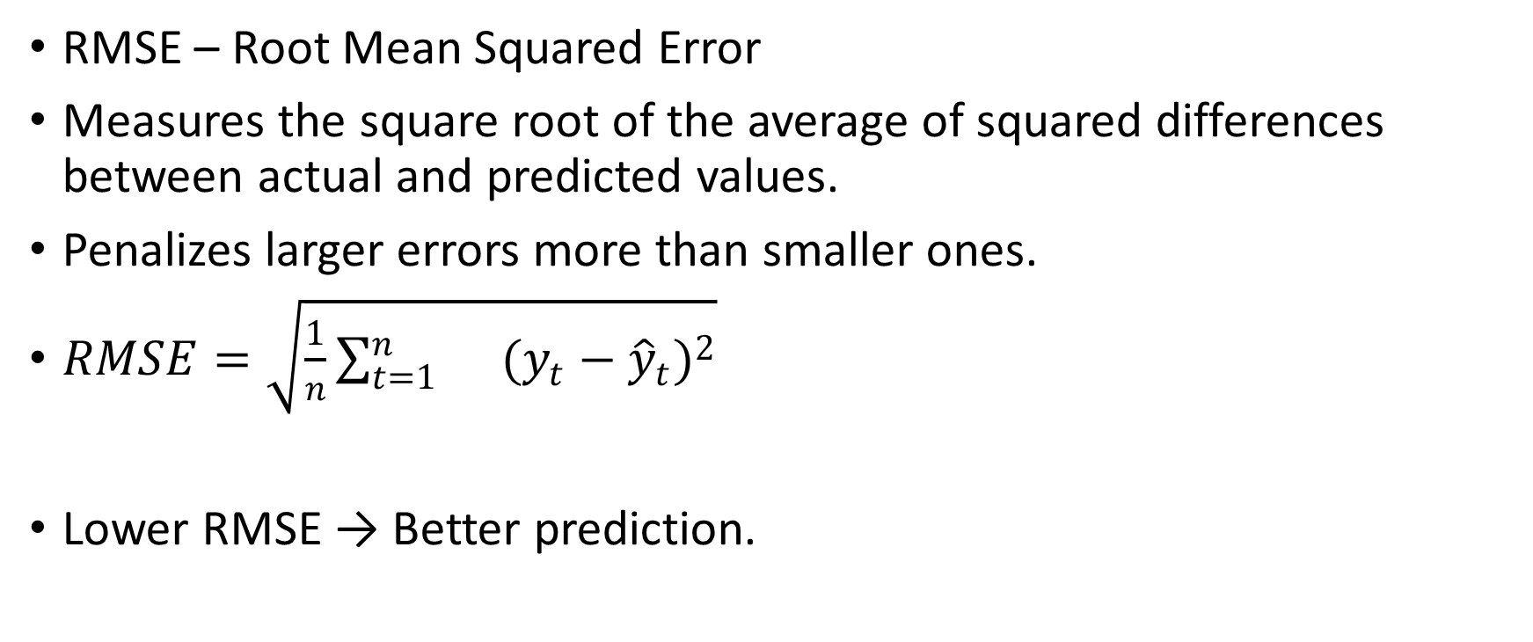
Evaluating the Forecast: RMSE, MAE, MAPE
RMSE – Root Mean Squared Error
Measures the square root of the average of squared differences between actual and predicted values.
Penalizes larger errors more than smaller ones.
$RMSE=\sqrt{\frac{1}{n}\sum_{t=1}^{n}{}(y_{t}−{\hat{y}}_{t})^{2}}$
Lower RMSE → Better prediction.

Slide 24

MAE – Mean Absolute Error
Measures the average absolute difference between actual and forecasted values.
More interpretable, same unit as the data.
$\text{MAE}=\frac{1}{n}\sum_{t=1}^{n}{}∣y_{t}−{\hat{y}}_{t}∣$

Slide 25

MAPE – Mean Absolute Percentage Error
Shows error in percentage terms, easy to understand.
Problematic when actual values are close to zero.
$\text{MAPE}=\frac{100}{n}\sum_{t=1}^{n}{}∣\frac{y_{t}−{\hat{y}}_{t}}{y_{t}}∣\%$

Slide 26
Day | Actual Visits (yₜ) | Forecasted Visits (ŷₜ)
1 | 1000 | 980
2 | 1020 | 1010
3 | 980 | 990
4 | 1050 | 1040
5 | 1030 | 1020

Slide 27
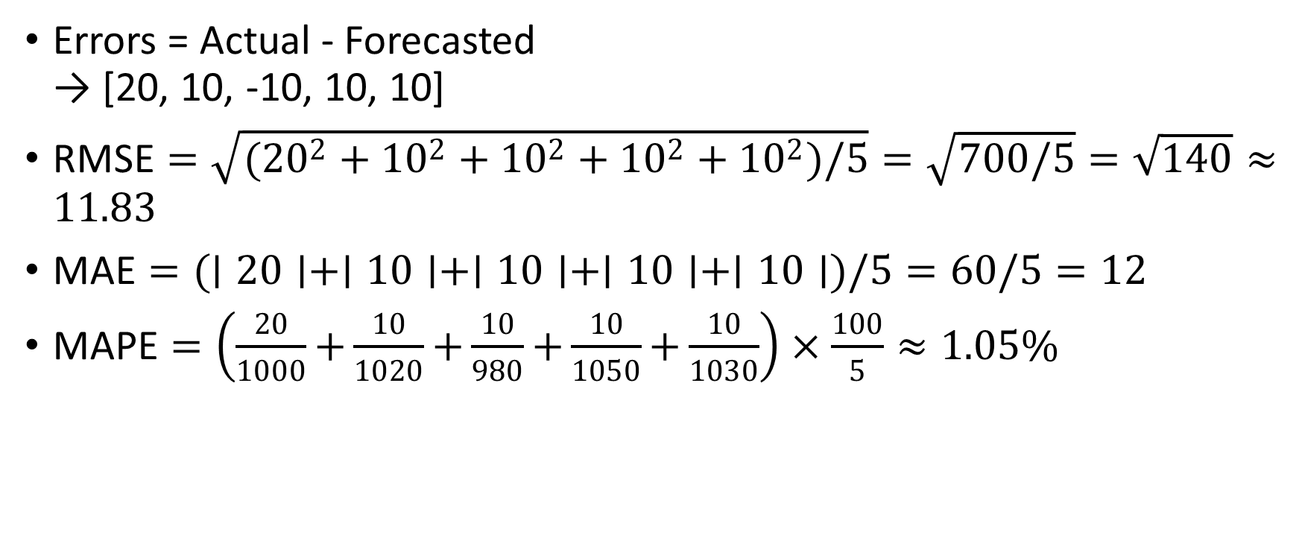
Errors = Actual - Forecasted → [20, 10, -10, 10, 10]
$\text{RMSE}=\sqrt{({20}^{2}+{10}^{2}+{10}^{2}+{10}^{2}+{10}^{2})/5}=\sqrt{700/5}=\sqrt{140}≈11.83$
$\text{MAE}=(∣20∣+∣10∣+∣10∣+∣10∣+∣10∣)/5=60/5=12$
$\text{MAPE}=\left(\frac{20}{1000} + \frac{10}{1020} + \frac{10}{980} + \frac{10}{1050} + \frac{10}{1030}\right)×\frac{100}{5}≈1.05\%$

